Slide 1
GitHub: Repositories & Portfolio Websites
James R. Bradley

Slide 2
GitHub
We will be interacting with github.com
git
Version control software
hub
The effective center of an activity, region, or network
Source: google.com
github.com
permits use of git…
As a hub for many people to download and contribute to files

Slide 3
GitHub Session
Repositories on github.com
repos
“Pages” web site
Free
Publish a portfolio of your work
Useful in your job search

Slide 4
GitHub Repositories (Repos)

Slide 5
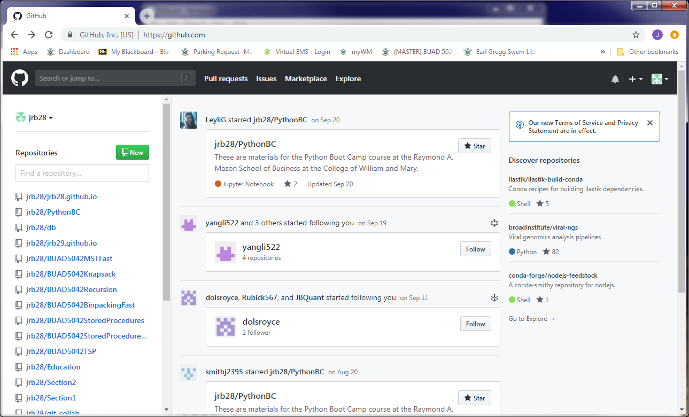
GitHub
Here is my github.com page
Multiple repositories (repos)
For distributing files

Slide 6


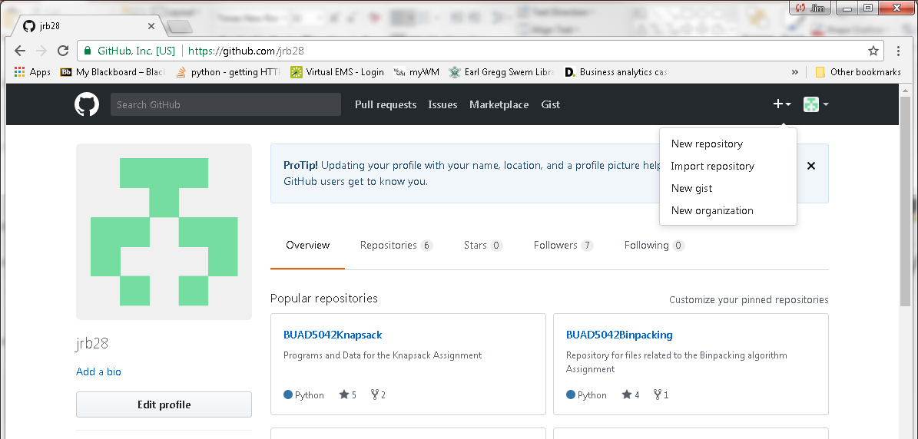
GitHub Repositories
Create account: go to https://github.com/
Create a repository

Slide 7
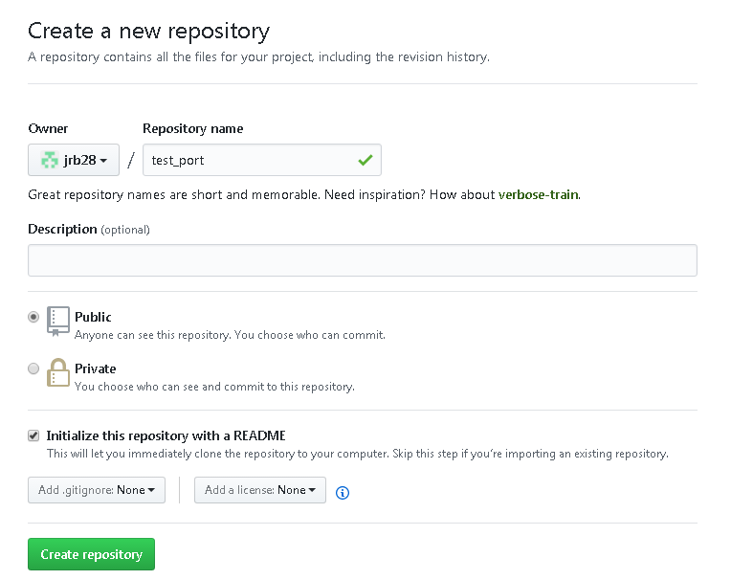
GitHub Repositories
Choose Public repository (free)
Choose Initialize this repository with a README
Customize README.md

Slide 8
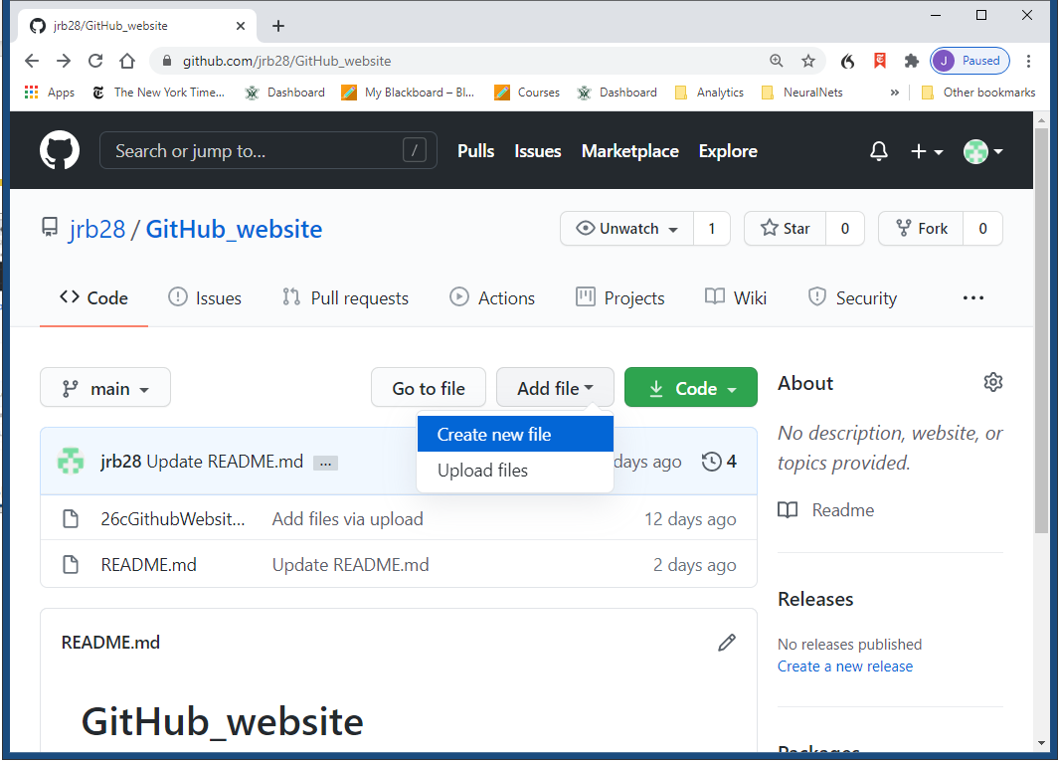
GitHub Repositories
Method 1 for uploading files
Click on Add File>Upload Files
Select files
Change commit message if desired
Click on Commit Changes
Method 2
Drag files onto repo page

Slide 9
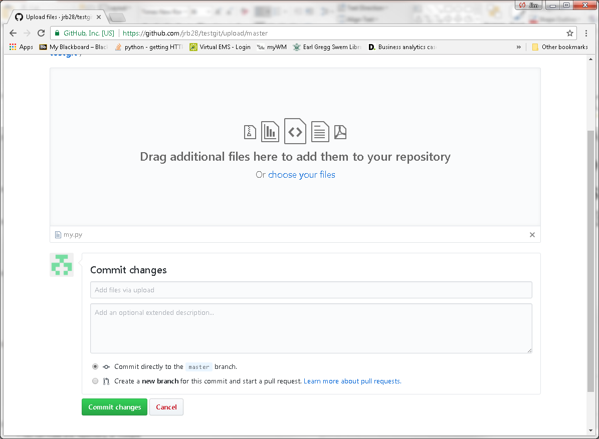
GitHub Repositories

Slide 10
Portfolio in GitHub Repository
Repos can be a part of your portfolio
Publish all code and documents on a single project in a repo
Code, Jupyter notebooks, presentations, reports, etc.
Jupyter notebooks in repos are rendered as html web pages
Opportunity to show your work and explain what you did
Use multiple repos
Each focuses on a different topics, job, or project
Organize your files within folders for neatness
All code in a folder
Readme document in root folder

Slide 11
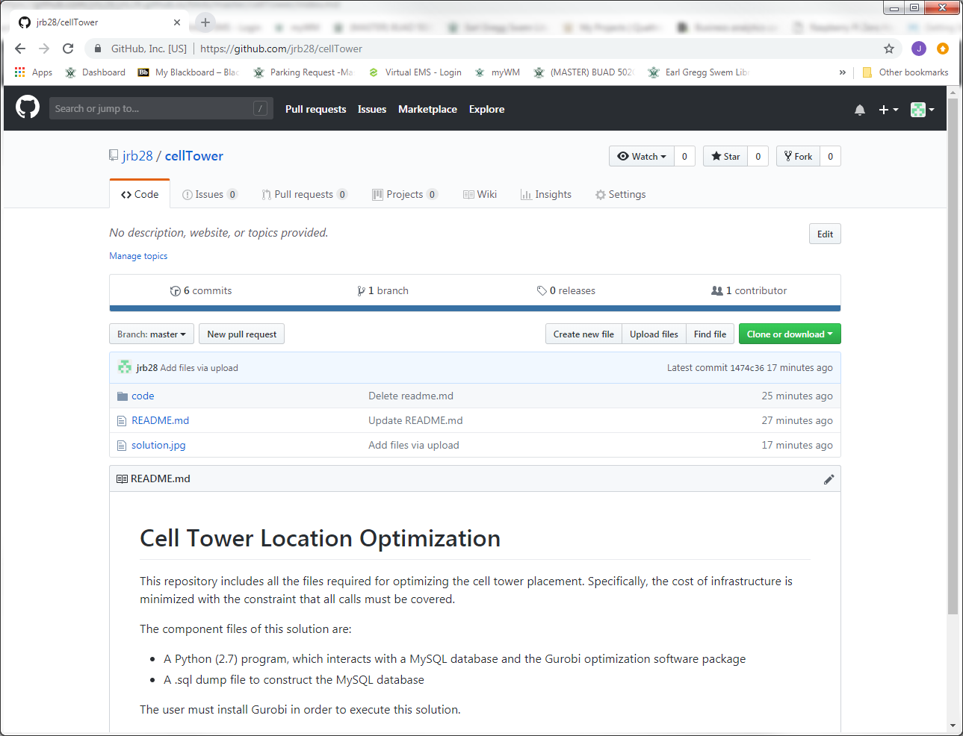
Portfolio in GitHub Repository
Example GitHub repo

Slide 12
GitHub Personal “Pages” Web Sites
Tour an Example
Setting it up
Creating content

Slide 13
https://bbailab.github.io/nn/
Small, but some ideas
Examples
Landing pages
Links to other pages
Images
Videos
Repos with code
Comments
Available templates are not sufficiently aesthetic
A little difficult to work with

Slide 14
GitHub Personal “Pages” Web Sites
Tour an Example
Setting it up
Creating content

Slide 15
Setting it Up
Create repository for web site
Enable web publishing
Choose template
Personalize template
Add content to web site
Web pages
Images: pictures, graphs
Videos: embedded and links to Youtube
Links to GitHub repos

Slide 16
Setting it Up
Create a GitHub repository with this name:
username.github.io
Your web page will be published here
username.github.io
Edit your site:
github.com/username/username.github.io

Slide 17
Setting it Up
Set source
Click on Settings
xxx
Choose theme
Click on Settings
Go to GitHub Pages section
Click on Change Theme
(optional) Download zip file
Right-click and Save Link As
Left-clicking doesn’t work for me (in Chrome)

Slide 18
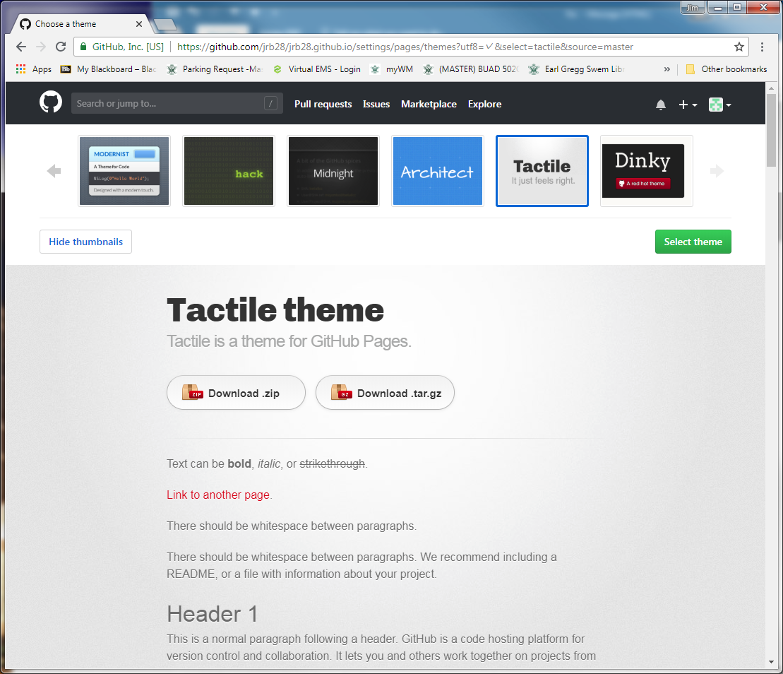
Setting it Up
Right-click and Save Link As…

Slide 19
Setting it Up
Unzip zip file
Notice file-folder structure: a complete web site
Upload all files & folders to
github.com/username/username.github.io
Commit Changes
You just created your web site
Need to customize it

Slide 20
Setting it Up
In browser, go to username.github.io
What’s happening
GitHub/Jekyll converts markdown files (.md) to HTML
index.md is the default web page
Text file: edit it as you wish
index.md
Jekyll
Web Site Generator
HTML
_config.yml
/_sass/*.scss
Sass (Syntactically Awesome StyleSheets)
CSS (Cascading StyleSheets)
SCSS (CSS for Ruby)

Slide 21
Setting it Up
Critical files to edit now
index.md
_config.yml (remove download buttons)
Possibly edit this file later
(if downloaded zip file)
_sass/Jekyll-theme-tactile.scss
Colors, fonts, etc.

Slide 22
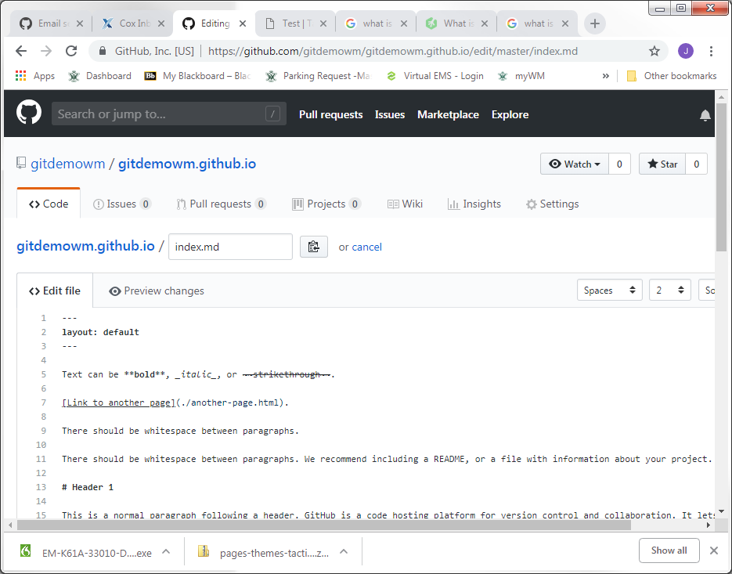
Setting it Up
Front Matter
Demarcated by “---” Controls some facets of web page content: Titles, Description, etc.
Markdown Content of web page

Slide 23
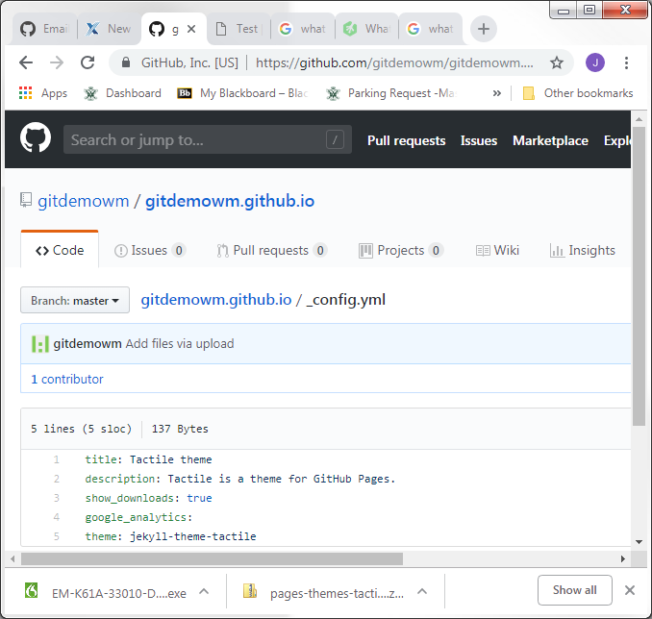
Setting it Up
Default Page Settings
Using layout: default in the .md front matter causes document to use all these attributes
Override these settings in .md using commands like: title: My Web Page

Slide 24
Setting it Up
View username.github.io again in browser
Note where title and description appear
Note download buttons
Edit index.md using text editor
Edit title and description in front matter
title: Test Title
description: Test Description
index.md must have front matter section
Start and End “---”
Edit _config.yml
Change show_downloads to false

Slide 25
GitHub Personal “Pages” Web Sites
Tour an Example
Setting it up
Creating content

Slide 26
Website Structures
Link content from index.md in root of username.github.io
Web site default landing page
Web site structure strategies
Organize with folders
Create project or topic web pages from markdown docs
Create separate websites from other repos
Link to a variety of content
Repos (e.g., code), Images, Videos
Jupyter notebooks
For download and visual rendering

Slide 27
Website Structures
Create project or topic web pages from markdown documents
Create project folder in root directory
Create index.md file within that folder
creates default landing page for that folder
Edit the index.md as desired
Link to the project index.md file from the root index.md file
[Alternate Text](path_to_item)
[Time Series](/timeseries/index.md)
Open index.md in timeseries subfolder of current folder

Slide 28
Portfolio Website on GitHub
Jupyter notebooks
In GitHub web site viewed through web browser
Save .ipynb notebooks as HTML for HTML view
[Jupyter Notebook (html)](TimeSeriesDecomposition.html)
.ipynb files are automatically downloaded otherwise
[Jupyter Notebook (ipynb)](TimeSeriesDecomposition.ipynb)
In repositories
.ipynb files are rendered as HTML
Non-functional

Slide 29
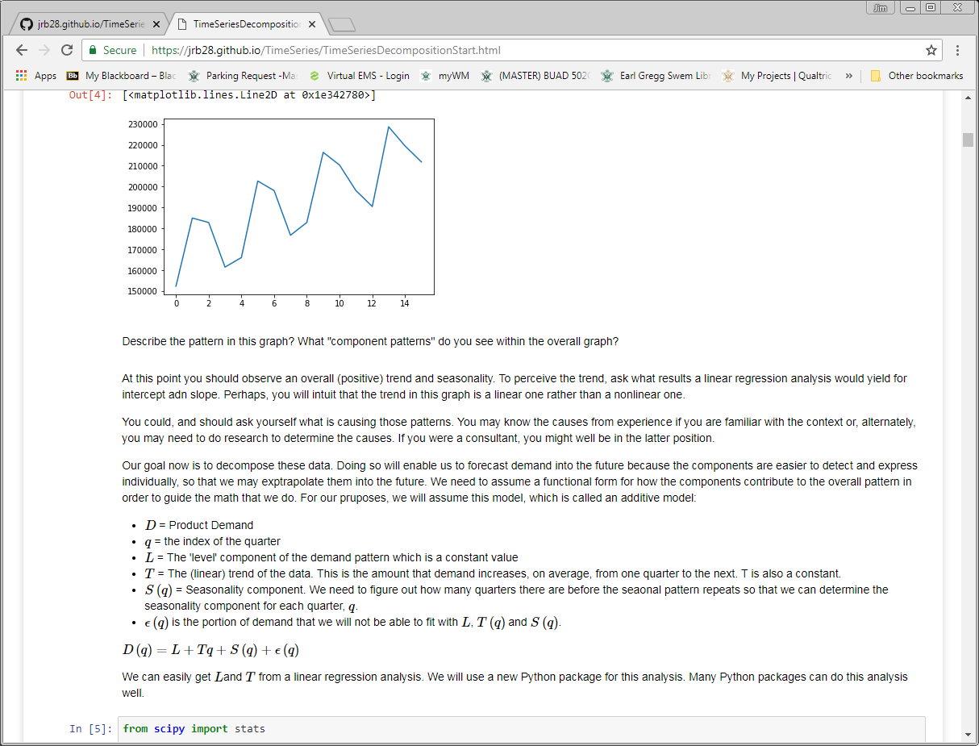
Portfolio Website on GitHub
Jupyter from a GitHub web page
Notice URL indicates .html file

Slide 30
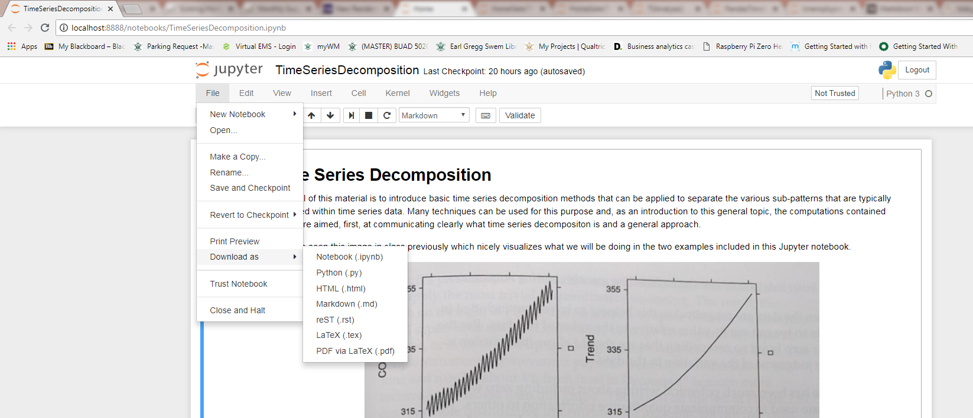
Portfolio Website on GitHub
How to convert Jupyter notebooks to html

Slide 31
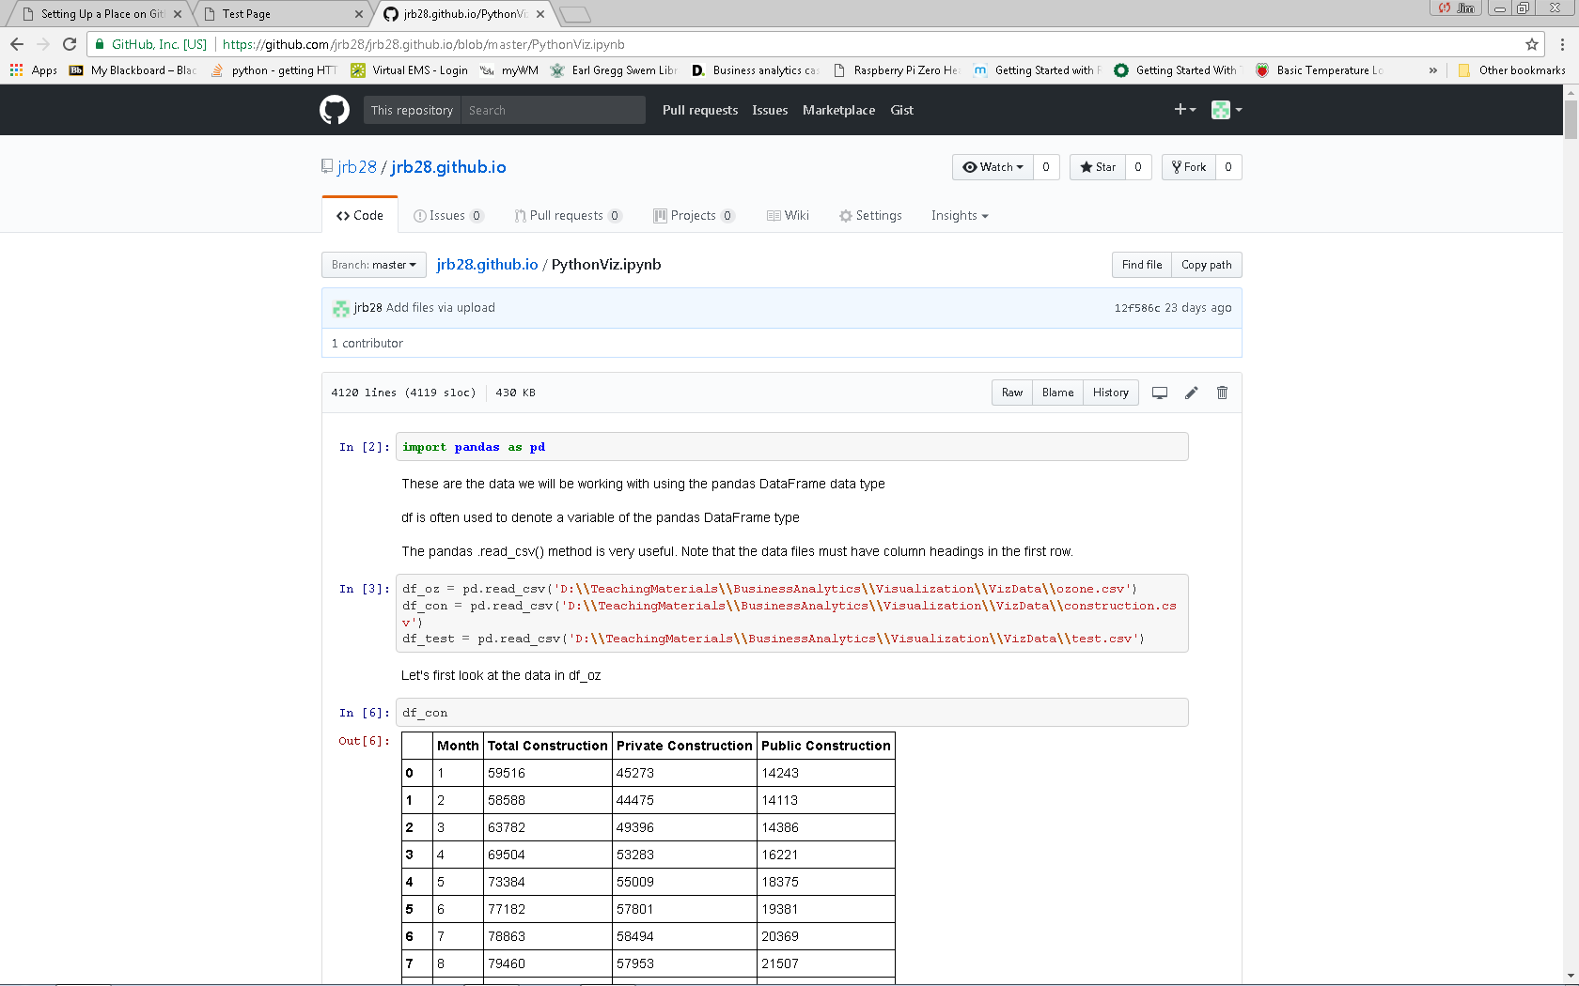
Portfolio Website on GitHub
Jupyter notebooks viewed in repository

Slide 32
Portfolio Website on GitHub
Links to images
![Picture](myPic.jpg)
Assuming image is in same folder
Links to videos on youtube
youtube video number is 123 in this example
[![Sorting](https://img.youtube.com/vi/123/0.jpg)](http://www.youtube.com/watch?v=123)
Links to repositories
[Repository](https://github.com/username/repo_name)

Slide 33
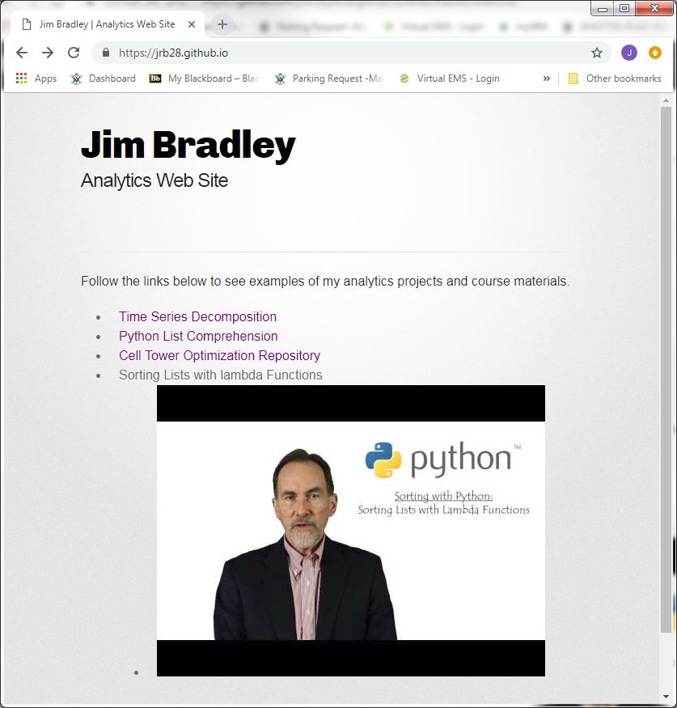
Portfolio Website on GitHub
My website
See repository for link examples

Slide 34
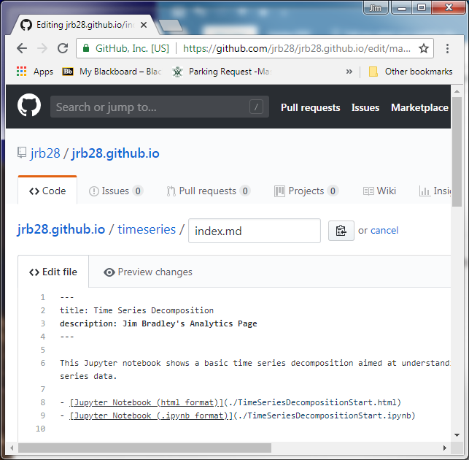
Tips
Each page should have a title and description between the set of three dashes
Edit .scss file in _sass folder for format revisions

Slide 35
Tips
There is a lag from when you load files and edit .md files and when they can be viewed online

Slide 36
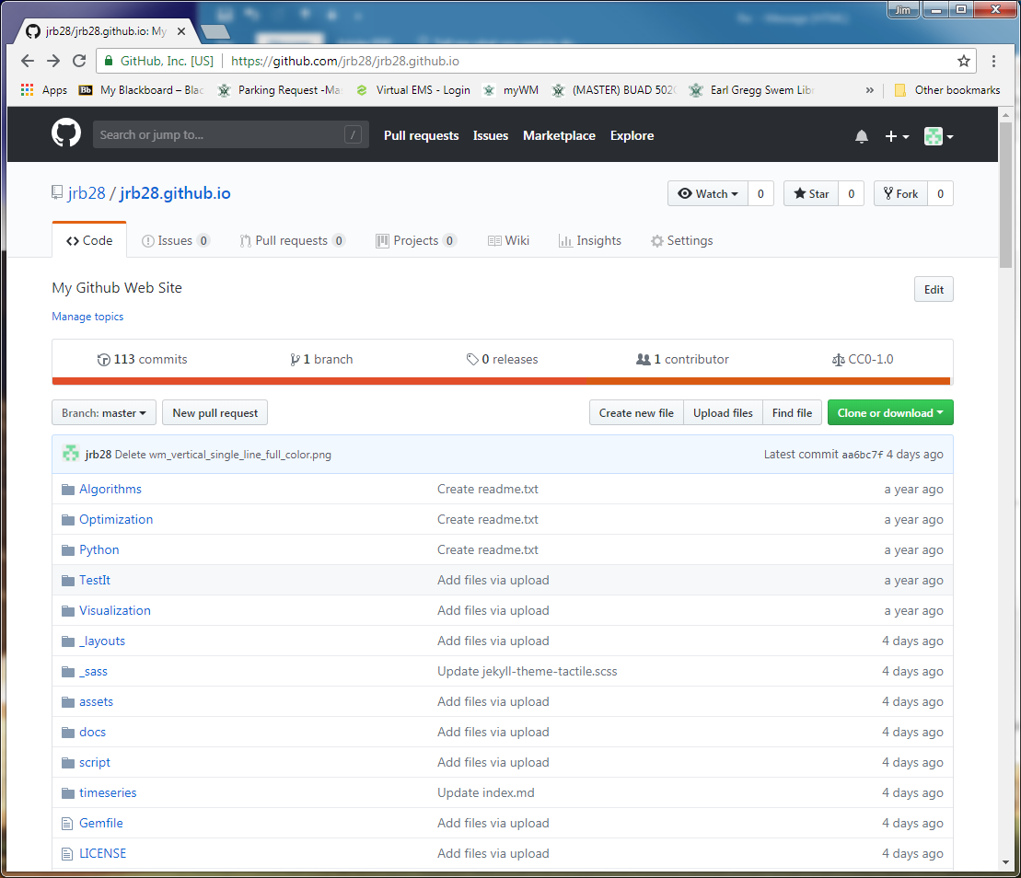
Tips
Manage website
Add files just like other repositories
Uploading content by dragging files from File Explorer to GitHub folder
Commit changes

Slide 37
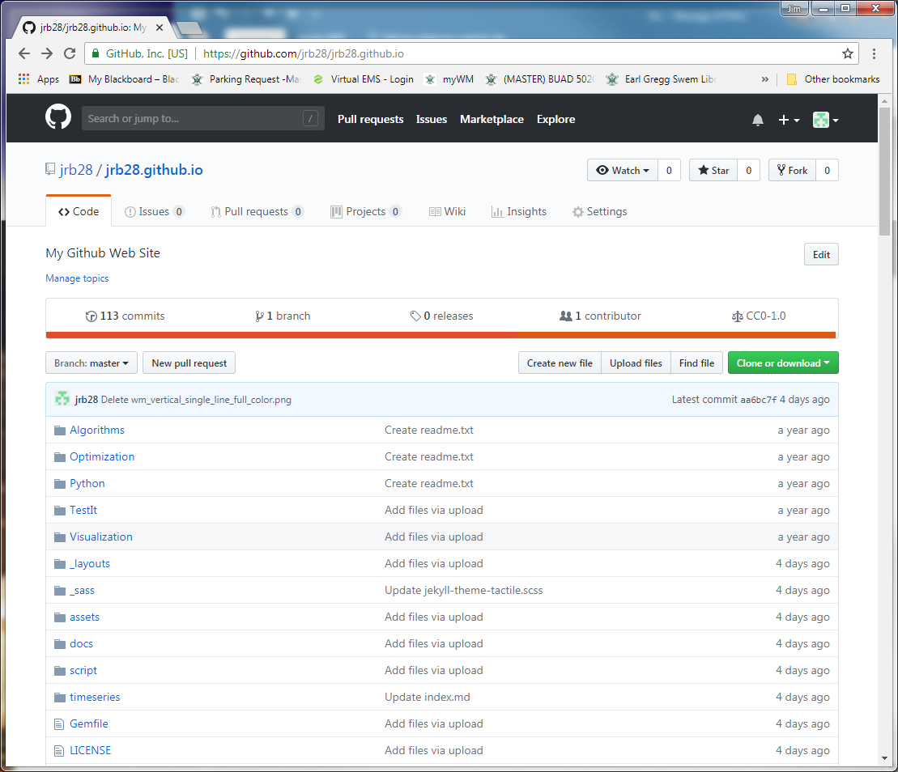
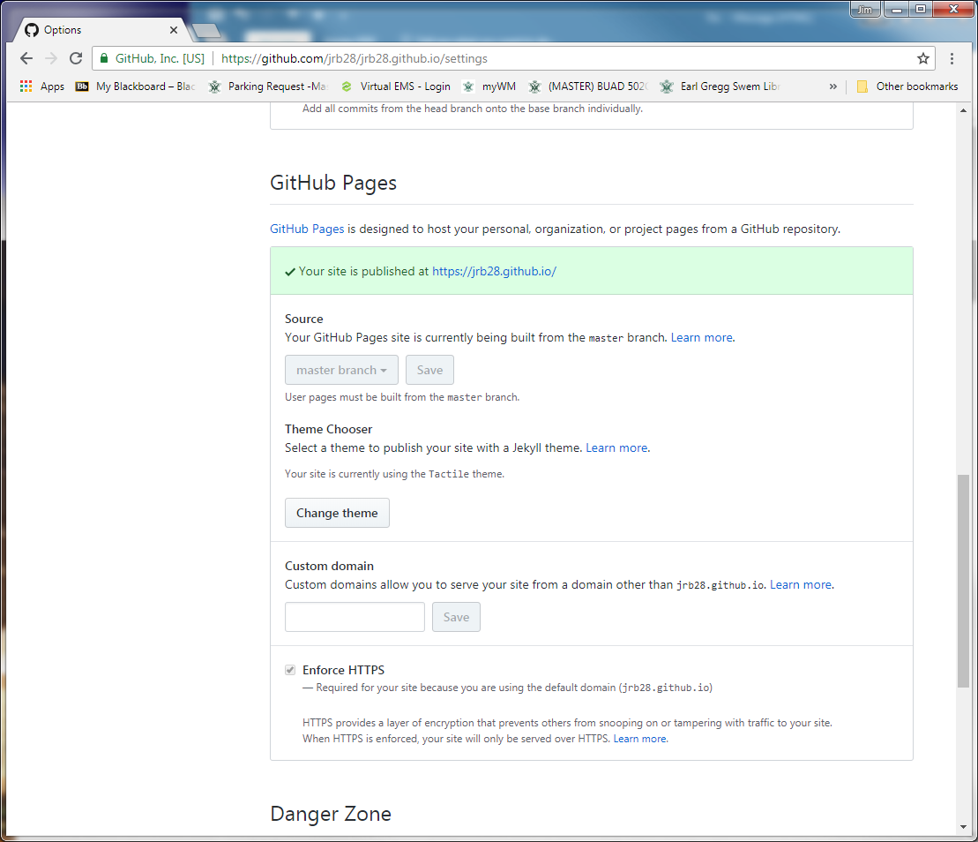
Tips
Change themes

Slide 38
Portfolio Website on GitHub
Resources & Ideas
https://dannguyen.github.io/github-for-portfolios/
See first tutorial for basics of setting up a GitHub web page
http://blog.udacity.com/2016/02/how-to-build-a-data-analysis-portfolio-that-will-get-you-hired.html
https://techbeacon.com/what-do-job-seeking-developers-need-their-github
https://help.github.com/articles/working-with-jupyter-notebook-files-on-github/
Jupyter and GitHub
https://www.dataquest.io/blog/how-to-share-data-science-portfolio/

Slide 39
Advanced Techniques

Slide 40
Topics
Use GitHub Desktop App
Manage website content
Make another repo into a website

Slide 41
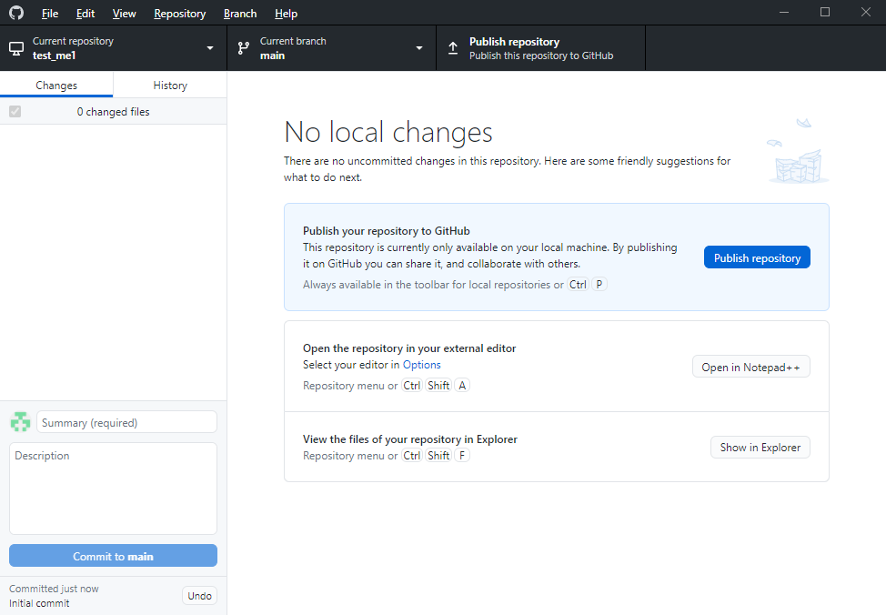
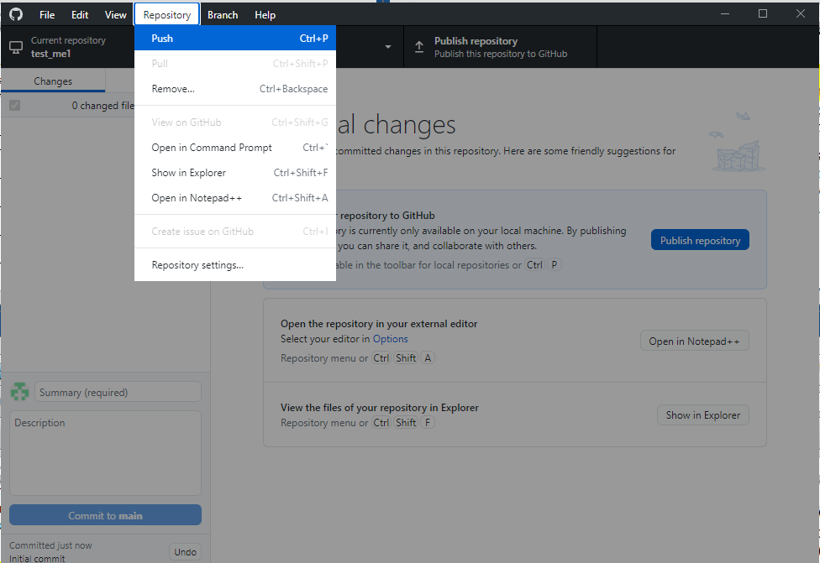
GitHub Desktop App
Create repo
File>New repository
Publish repo on GitHub.com
Click Publish Repository button
(or) Repository>Push

Slide 42
GitHub Desktop App
Work on content on desktop GitHub folder
Commit Changes on desktop
xxxx
Push changes to GitHub.com
xxx

